Slide 1
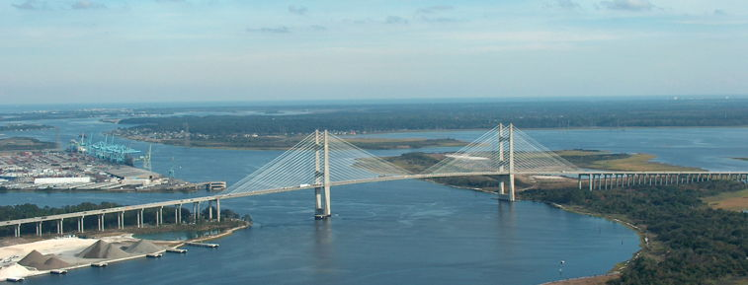
State of the River Report
for the Lower St. Johns River Basin
Water Quality, Fisheries, Aquatic Life, Contaminants
2015
Lower Basin of the St. Johns River Jacksonville, FL
Radha Pyati, Ph.D.
University of North Florida

Slide 2




About the Report
Funded by COJ Environmental Protection Board
Purpose
  Inform the public about the LSJRB health
  Provide independent assessments of status and trends
  First annual report in 2008
Authors
  Dr. Radha Pyati, UNF
  Dr. Stuart Chalk, UNF
  Dr. Gretchen Bielmyer, VSU
  Dr. Peter Bacopoulos, UNF
  Dr. Brian Zoellner, UNF
  Dr. Lucy Sonnenberg, JU
  Dr. Gerry Pinto, JU
  Dr. Nisse Goldberg, JU
  Dr. Andy Ouellette, JU
  Brochure Design: David Smith, JU

Slide 3
About the Report
Peer Reviewers and Advisors:
  SJRWMD
  City of Jacksonville
  FL Dept. of Health
  FDEP
  JEA
  St. Johns Riverkeeper
  Middlebrook Company
  The Nature Conservancy
  FWRI
  FL Sea Grant
  National Park Service
  Wildwood Consulting
  UNF
  JU
  Valdosta State
Special thanks to:
  Dr. Ray Bowman
  Dr. Quinton White
  Dr. Dan McCarthy
  Ms. Heather McCarthy
  Dr. Pat Welsh

Slide 4
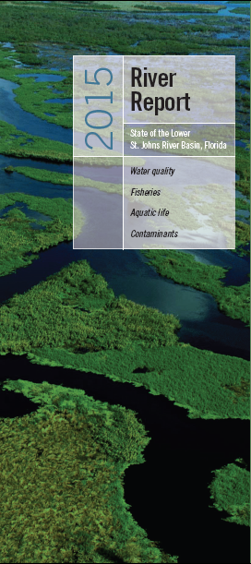
About the Report
SJRreport.com
Topics
  Background
  Water Quality
  Fisheries
  Aquatic Life
  Contaminants
Full Report
Appendices
Digital archive of references
Website
Brochure -
Interactive tributaries
A new look!
A new look!

Slide 5
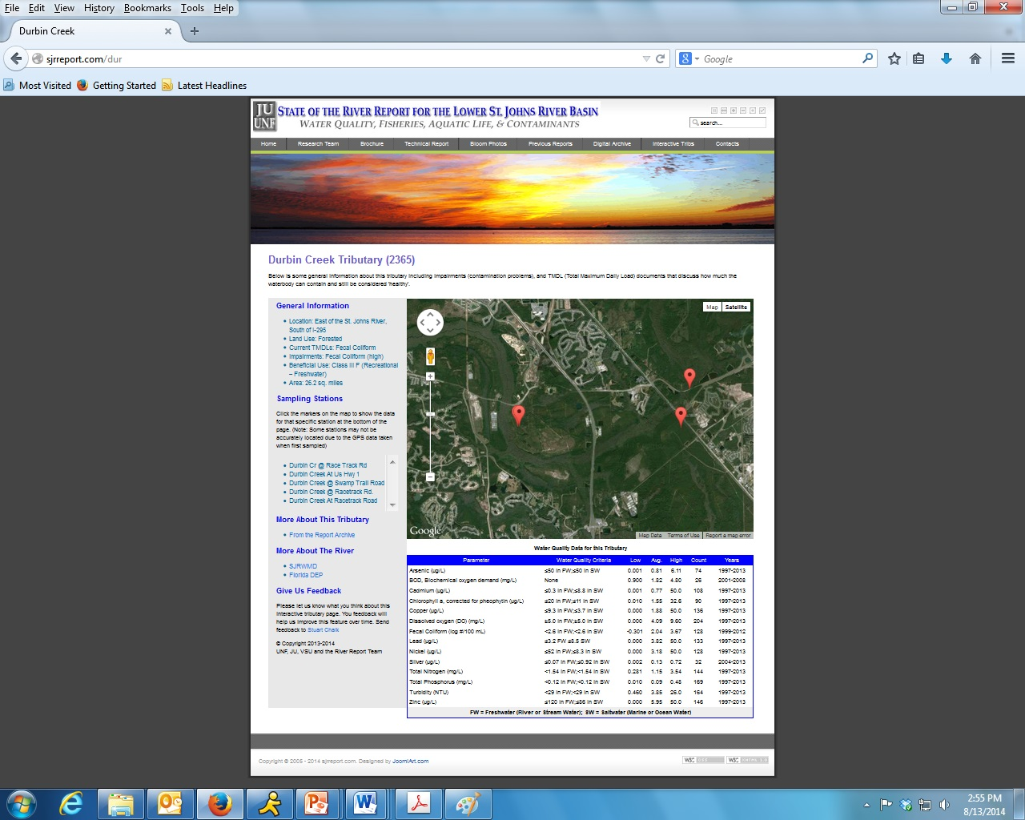
Interactive Tributary Page

Slide 6
Water Quality
Indicator | Status | Trends
Salinity | Uncertain | Worsening
Fecal Coliform | Unsatisfactory | Uncertain
Turbidity | Satisfactory | Improving
Dissolved Oxygen | Unsatisfactory | Mainstem FW: Unchanged Mainstem SW: Improving Tributaries: Worsening
Algal Blooms | Unsatisfactory | Unchanged
Nutrients | Nitrogen: Unsatisfactory Phosphorus: Unsatisfactory | Nitrogen: Improving Phosphorus FW: Unchanged Phosphorus SW: Improving

Slide 7
Fecal Coliform
LSJRB tributaries impaired for fecal coliform: 75 total as of 2014. Of those, 25 have final BMAPs.
Of those 25, in 2013, 17 showed 50% or greater reduction in median FC value observed at time of TMDL determination.
  Deer, Goodby’s ,Hogan, Miramar, Newcastle, Blockhouse, Cormorant, Deep Bottom, Fishing, Greenfield, Lower Trout, McCoy, Middle Trout, Moncrief, Pottsburg, Sherman, Wills
Eight showed less than 50% reduction in median: Big Fishweir, Butcher Pen, Miller, Open, Terrapin, Craig, Hopkins, Williamson Creeks
Methodology for evaluating FC levels is changing for 2015 onward.

Slide 8
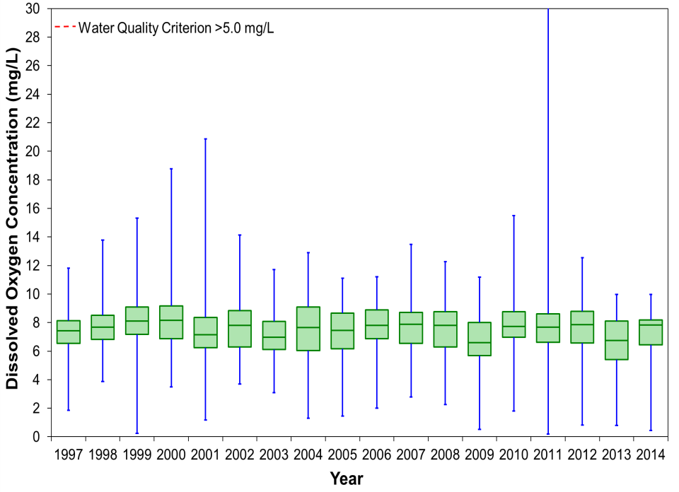
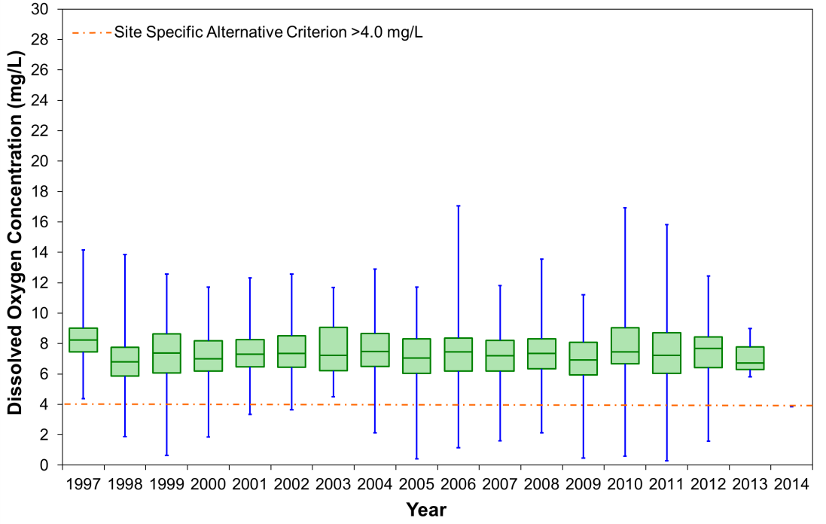
Dissolved Oxygen
Freshwater
Saltwater
Saltwater minima are increasing, indicating improvement. Freshwater minima are not.

Slide 9
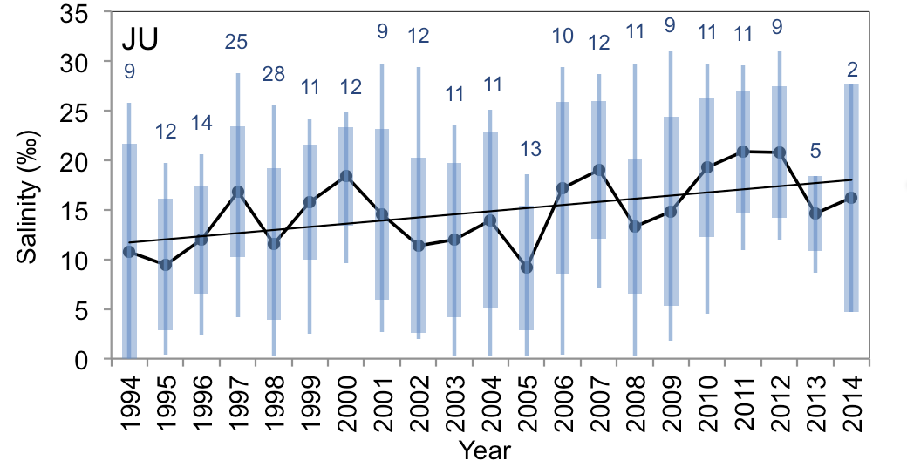
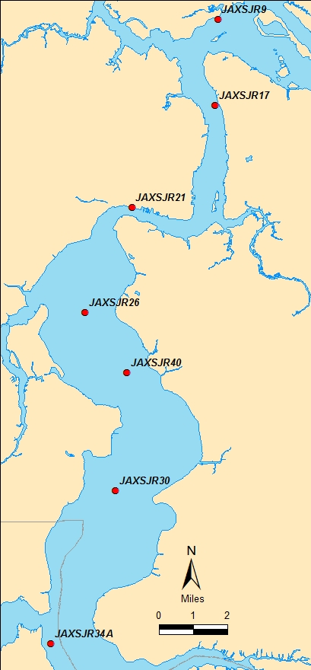
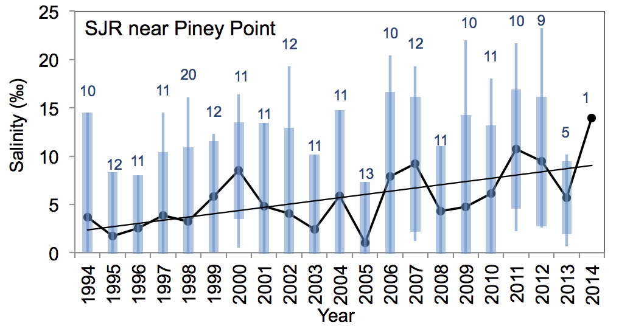
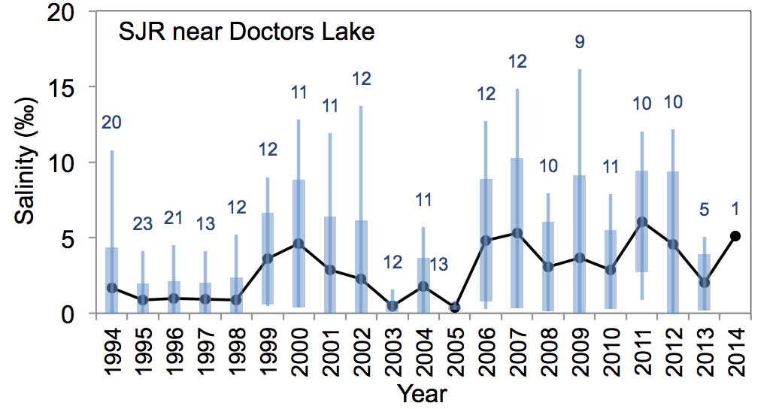
Salinity
Fluctuations with weather
  Drought
  Hurricanes
Daily fluctuations with tide up to Shands Bridge
Increasing mean salinity

Slide 10
Salinity
Potential impacts in the Lower Basin
  Movement south of transition zones
  Redistribution of salt and freshwater fish
  Life-cycle disruption of organisms that need marine and freshwater habitats (e.g., crabs, shrimp)
  Shifts in macroinvertebrate populations
  Less SAV in the north
  Less freshwater hardwood swamps in some areas

Slide 11
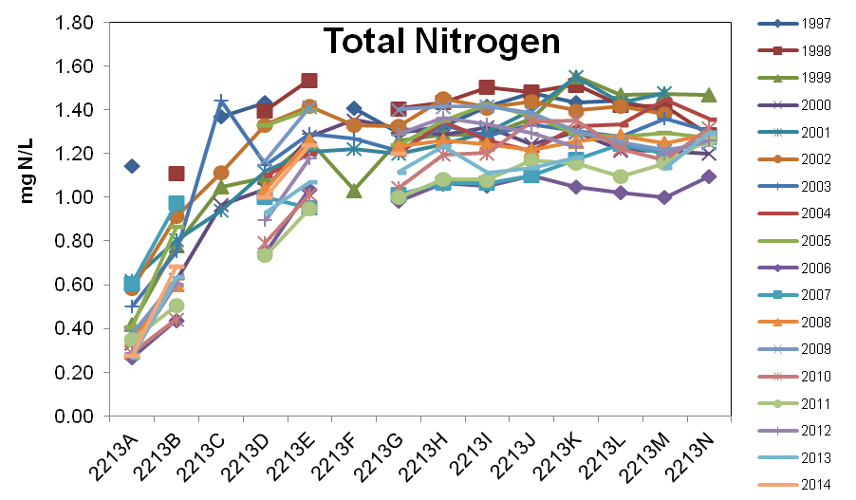
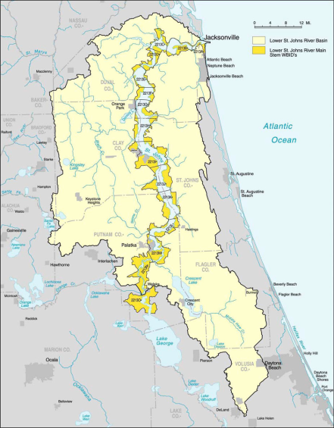
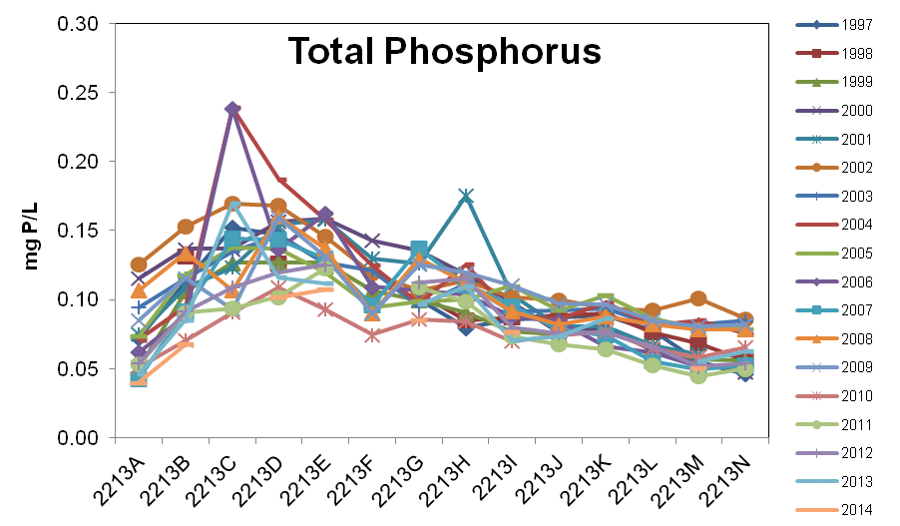
Nutrients
Nutrients vary with distance to mouth
Data divided into marine/estuarine and freshwater regions
Salt Water ---------------------------- Fresh Water

Slide 12
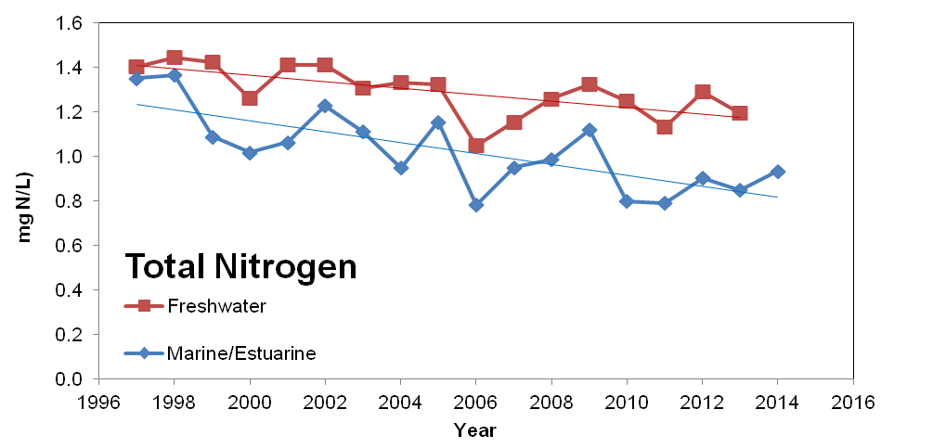

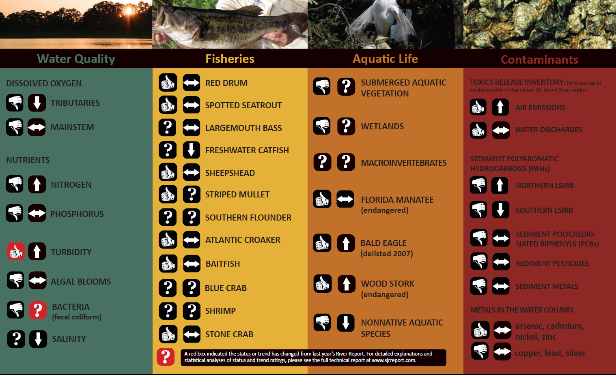
Nutrients
Total Nitrogen Trend
  Annual average declining in fresh to marine water (Spearman Rank p <0.05)
INDICATOR | STATUS | TREND
Nitrogen | Unsatisfactory | Improving

Slide 13
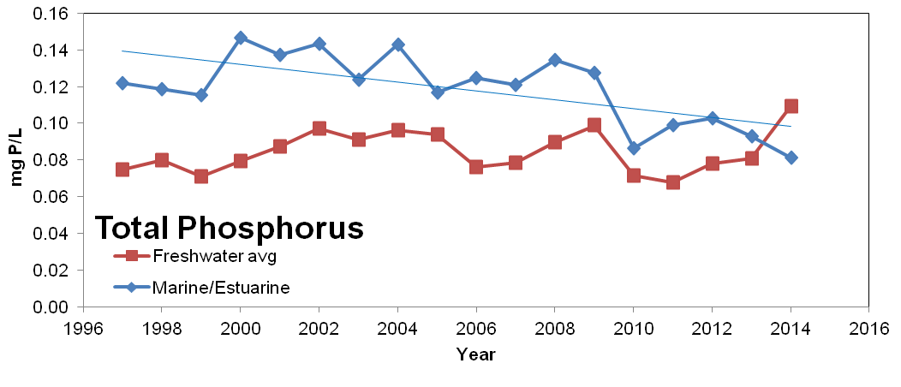
Nutrients
Total Phosphorus Trend
  Annual TP averages decreasing in marine/estuarine, freshwater unchanged (Spearman Rank p > 0.05)
INDICATOR | STATUS | TREND
Phosphorus | Unsatisfactory | Improving
Notes:
Decrease

Slide 14
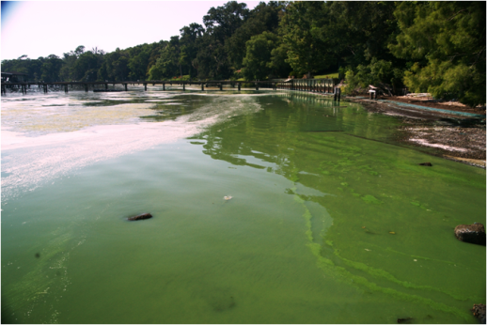
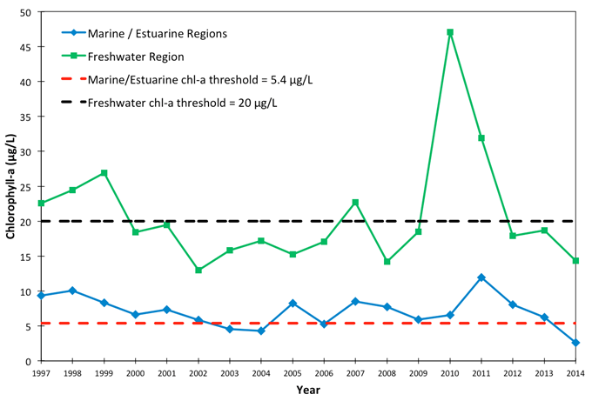
Chlorophyll-a
Trend
  No trends in annual average (Spearman Rank p >0.05)
  Not all blooms are sampled, miss reported toxic events
  Better assessments needed
INDICATOR | STATUS | TREND
Algal Blooms | Unsatisfactory | Unchanged

Slide 15
Aquatic Life
Indicator | Status | Trends
Submerged Aquatic Vegetation | Unsatisfactory | Uncertain
Wetlands | Unsatisfactory | Uncertain
Macroinvertebrates | Uncertain | Uncertain
Threatened and Endangered Species | Satisfactory | Improving, Unchanged
Nonnative Aquatic Species | Unsatisfactory | Worsening

Slide 16
SAV
Tape grass
Vallisneria americana
Water naiad
Najas guadalupensis
Horned
pondweed
Zannichellia palustris
Awl-leaf arrowhead
Sagittaria subulata
Widgeon grass
Ruppia maritima
Significance
  Nurseries
  Food
  Improves water quality
  Reduces erosion
Critical Conditions
  Salinity
  Water clarity
  Shoreline condition
  Epiphytes
Data
  SJRWMD, 2000-2011
  Transects in 6 sections of LSJR
  Aerial observations 2008-2015
Photos by permission: SJRWMD 1998 Volunteer guide to aquatic plants in the LSJR
Notes:
Common species in LSJRB shown, esp. Vallesneria
Vital for all aspects of aquatic health: food, nurseries, water quality, shoreline
Complex interactions of salinity and water clarity along w/ shoreline and presence of plants that cover leaves reducing photosynthesis
Gerry wrote section with data from SJRWMD 2000-2011 headed up by (Dean Dobberfuhl, Chuck Jacoby, Lori McCloud and others) and aerial observations (JU-MSRI) from 2008-2013.
Remember grass grow best from 0-12ppt; can tolerate 15-20ppt for short periods; SAV needs more light in higher salinity environments
Will describe some of the former data in the following

Slide 17
SAV
Summary
  Highly variable over time due to weather and other factors
  Decline in grass bed coverage
  End of monitoring in 2011 limits understanding of SAV dynamics at a critical time
INDICATOR | STATUS | TREND
Submerged Aquatic Vegetation | Unsatisfactory | Conditions worsening
Notes:
Submerged aquatic vegetation (SAV), has experienced fairly stable levels south of Buckman Bridge, with variations caused by drought and increased salinity.
Declines in SAV north of Buckman since 1998.
Any declines/fluctuations in the south tend to be more due to color in the water limiting growth - from periodic storm events rather than salinity spikes.
SAV is essential to the survival of many other aquatic species as both food and spawning area.
About 12 species, but Val.. is the dominant species.

Slide 18
Contaminants
INDICATOR | STATUS | TREND
Chemical Releases (TRI) | Air – Satisfactory Water - Unsatisfactory | Air – Improving Water - Unchanged
Water Metals | Mixed | Conditions Unchanged
Sediments | Unsatisfactory | Conditions Unchanged

Slide 19
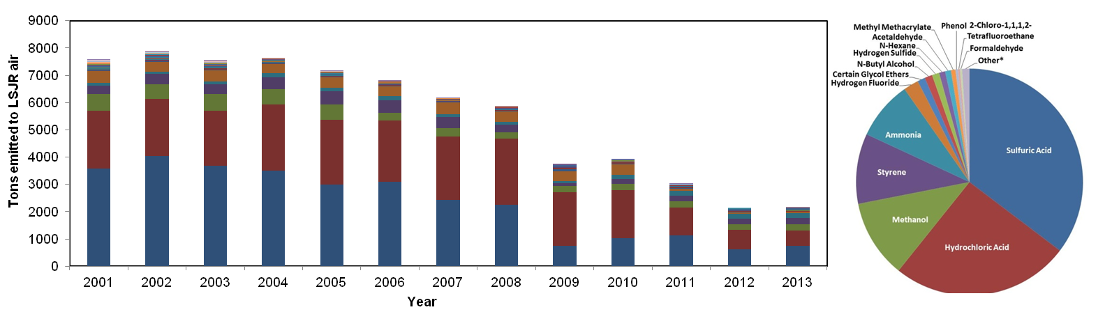
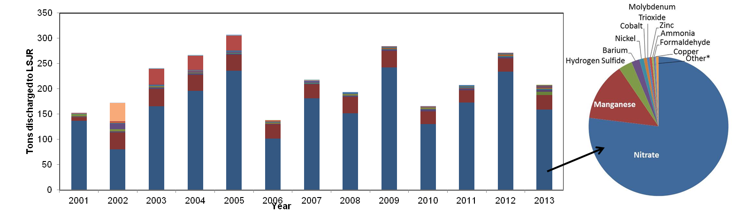
Contaminants
Toxics Release Inventory
Point sources of chemicals from permitted industries
Total chemical releases to air
Total chemical releases to water

Slide 20
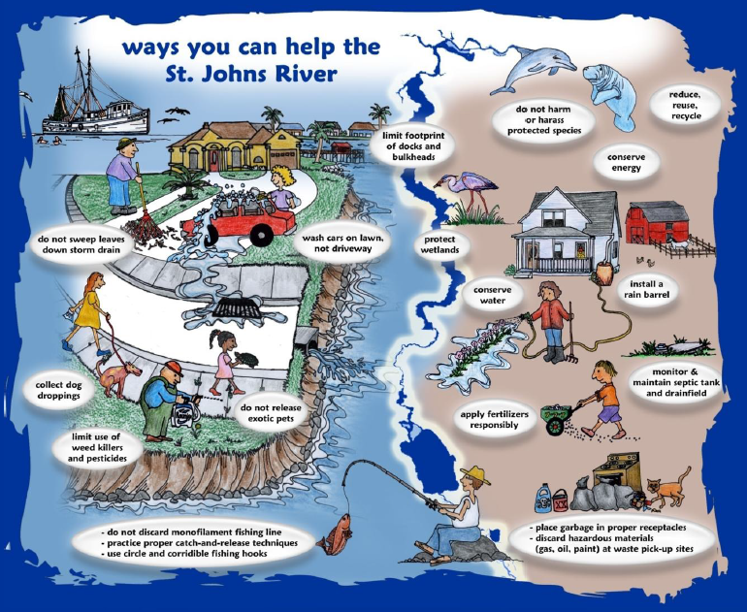
By Heather McCarthy
Thank you! Questions?

